Slide 1

Spotify Songs Analytics Dashboard
M S c I N D A T A S C I E N C E · DA T A V I S U A L I Z A T I O N
An interactive Python dashboard for exploring song popularity and audio features.
PRESENTER
Pakala Sai Vamshi
MATRICULATION NUMBER
69351172
PROGRAM
MSc in Data Science
UNIVERSITY
University of Europe for Applied Sciences (UE)

Slide 2
Introduction
Spotify hosts millions of songs, making music analytics essential to understand trends, popularity, and listener preferences.
Spotify streams billions of songs, generating vast listening and metadata. Music analytics decodes trends in popularity, genre, and audio traits.
Data visualization turns raw numbers into clear musical insights.
This dashboard analyzes song attributes to uncover popularity patterns. Expected outcome: a clear, interactive view of what makes songs popular.
02

Slide 3
Problem Statement & Objectives
Large, unstructured music datasets make manual trend discovery difficult, motivating an interactive dashboard solution.
Problem Statement
Growing need for reliable music analytics tools
Objectives
Analyze songs across popularity and audio dimensions
Datasets contain thousands of songs and features
Study popularity distribution across the full dataset
Identifying popularity trends manually is difficult
Compare artists and tracks using key metrics
Static reports fail to support dynamic exploration
Visualize relationships between audio features
Interactive dashboards are needed for real-time insight
Develop a fully interactive analytics dashboard
03

Slide 4
Dataset & Technology Stack
Built on a large real-world Spotify dataset using a modern Python-based analytics and visualization stack.
Dataset contains 35,200 songs from 9,202 unique artists.
Key features: popularity, danceability, energy, tempo, valence.
Also includes acousticness, speechiness, liveness, explicit flag.
Python
Streamlit
Built using Python with Pandas for data processing and cleaning.
Visualized with Streamlit, Plotly Express, and Figure Factory.
Pandas
Plotly
04

Slide 5
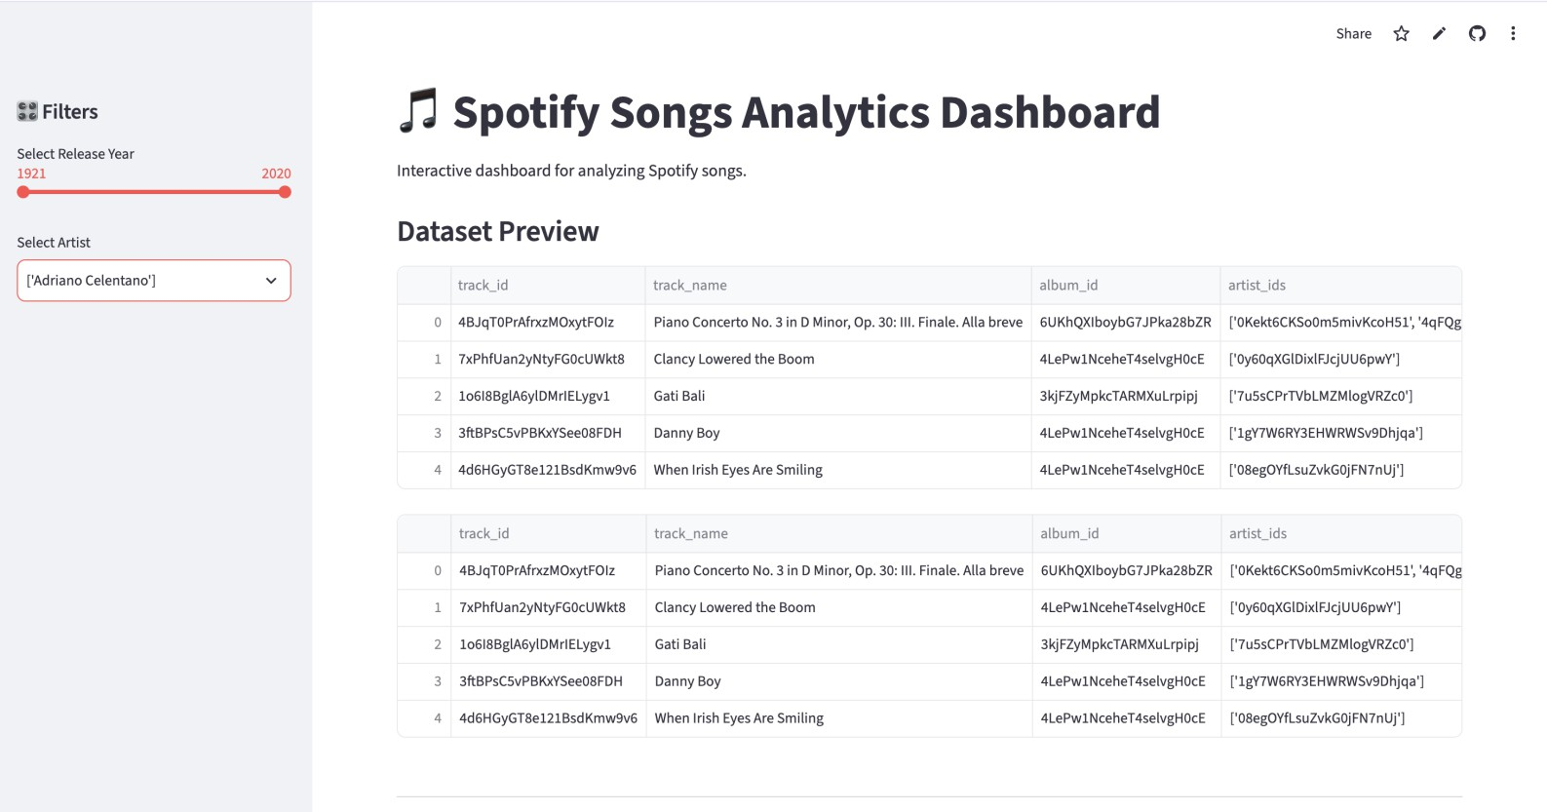
Dashboard Overview
The dashboard offers an intuitive interface with dynamic filters, letting users explore the dataset interactively.
Dataset preview displays raw song and artist records instantly. Sidebar filters allow selection by release year and artist.
Fully interactive charts respond instantly to filter changes. Clean, responsive interface designed for smooth navigation Dynamic analysis updates every visual as filters change.
.

Slide 6
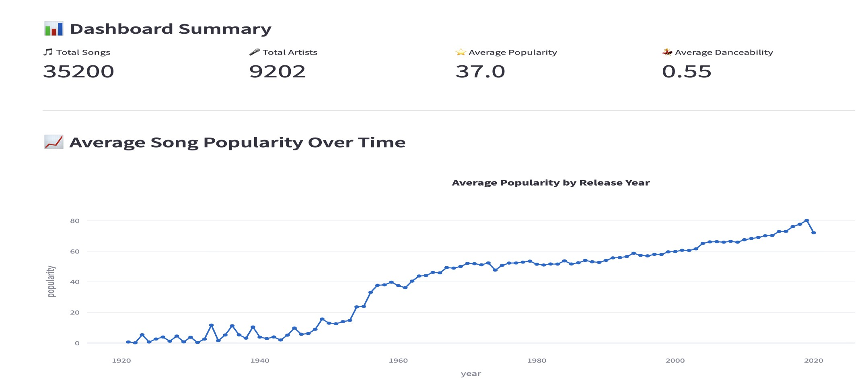
KPI Dashboard & Trend Analysis
Key indicators summarize the dataset at a glance, while the trend chart reveals how popularity evolved over time.
KPI cards show total songs, artists, and average metrics. Dataset includes 35,200 total songs and 9,202 artists.
Average song popularity score stands at 37.0 overall. Average danceability across all tracks measures 0.55. Popularity rises sharply from the 1950s to the present.

Slide 7
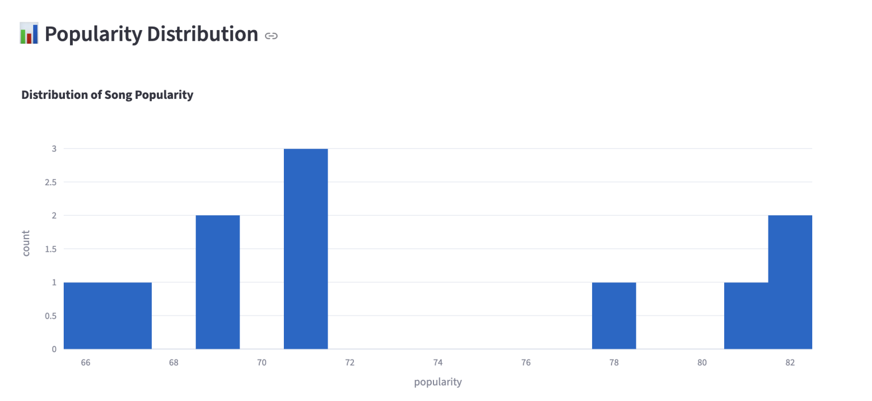
Popularity Analysis
Ranking and distribution charts reveal which songs perform best and how popularity scores spread across the dataset.
Top 10 chart ranks the most popular songs by score.
“Love Yourself” and “Sorry” lead as top popular tracks. Histogram displays the overall spread of popularity scores. Most songs cluster within a moderate popularity range.
Visual ranking helps spot standout, chart-topping tracks fast.

Slide 8
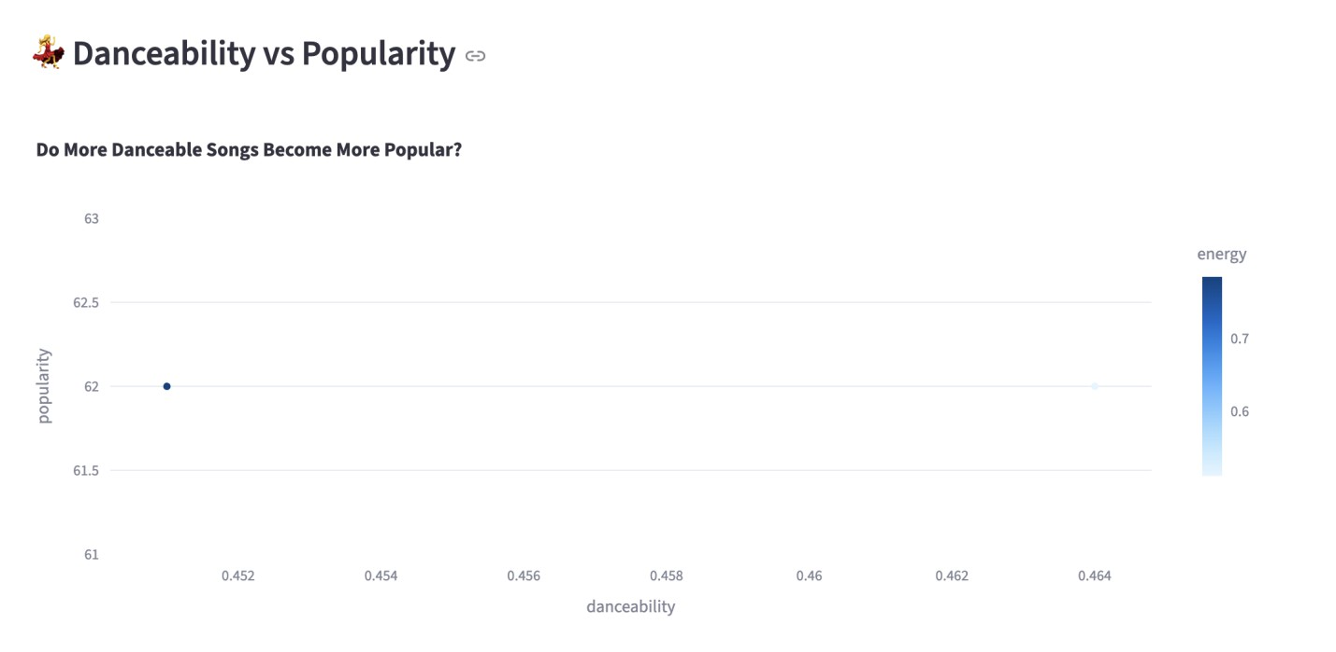
Danceability Analysis
This scatter plot explores whether more danceable songs tend to achieve higher popularity scores.
Scatter plot compares danceability against song popularity. Color encodes energy level for deeper multi-feature comparison. Correlation between danceability and popularity appears weak. Energy adds useful context to danceability's role in scoring.
Users can explore individual points interactively for details.

Slide 9
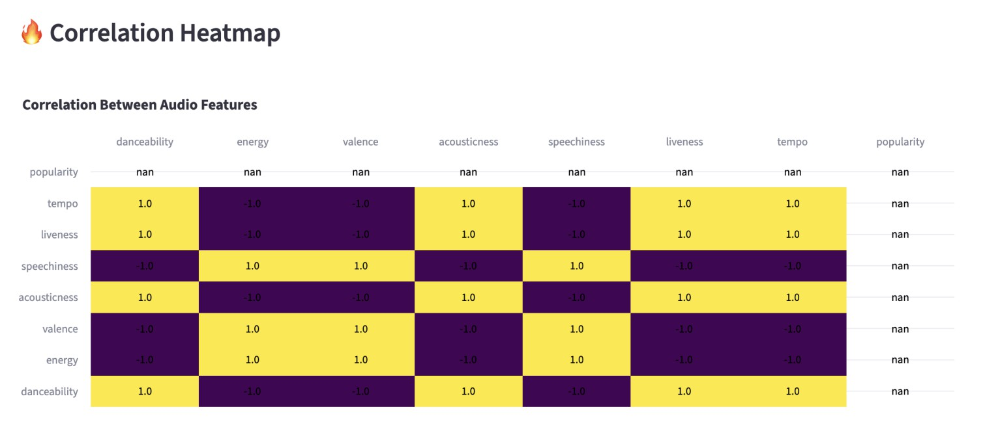
Correlation Analysis
The heatmap visualizes relationships between audio features, showing which factors move together or oppose each other.
Acousticness shows the strongest positive link to popularity. Energy correlates negatively with popularity, at -0.46.
Energy and acousticness show a strong negative link, -0.83. Speechiness also shows a moderate positive correlation.
Heatmap guides feature selection for deeper analysis.

Slide 10
Key Insights
Analysis of the dashboard reveals meaningful patterns in music popularity and audio feature relationships.
Song popularity has grown steadily since the mid-20th century. Acousticness and speechiness relate positively to popularity.
Energy shows a surprising negative link with popularity. Artist and year filters enable focused, comparative analysis. Dashboard makes complex audio data easy to interpret.

Slide 11



Advantages, Limitations & Future Scope
The dashboard delivers strong usability today, with clear opportunities for future enhancement and expansion.
Advantages
Limitations
Future Scope
Fully interactive exploration
Uses a static dataset
Machine learning integration
Fast, responsive performance
No live Spotify API access
Song recommendation system
Simple and easy to use
Limited to given feature set
Cloud-based deployment
Professional visualization style
Real-time Spotify API access
Clear, actionable insights

Slide 12
Conclusion
This project shows how interactive dashboards turn raw music data into meaningful, actionable insights.
Built an interactive Spotify analytics dashboard using Python.
Highlighted the power of data visualization for trend discovery.
Demonstrated practical benefits of dashboards for decisions. Applicable to music platforms, marketing, and artist strategy. Strengthened skills in Python, Streamlit, and Plotly development.
REFERENCES
Spotify Dataset · Kaggle · Python Documentation · Pandas Documentation · Plotly Documentation · Streamlit Documentation

